Slide 1
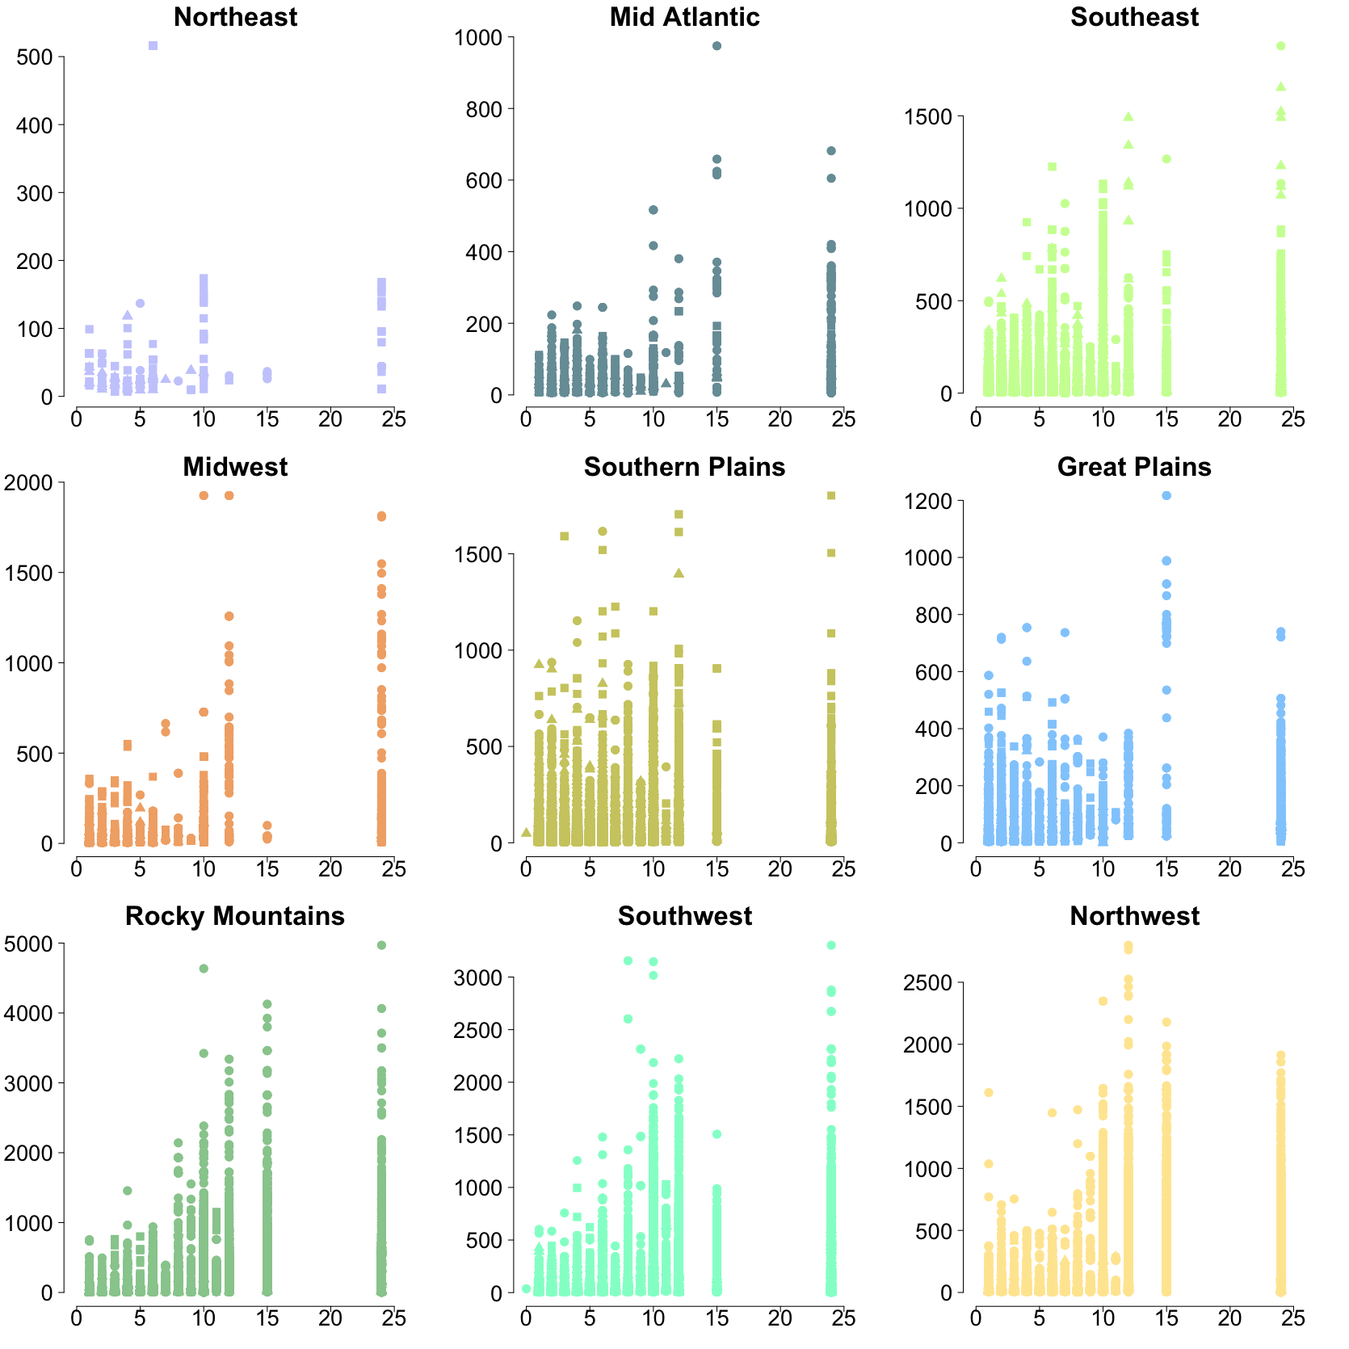
What relationships are there between MODIS fire detections and fires that trigger NWS smoke forecasts?
Steven Brey | sjbrey@colostate.edu
3
HMS duration is proportional to MODIS FRP
Colorado State University
Fort Collins, Colorado
Month Legend
6, 7, 8, 9, 10
1
3, 4, 5
Introduction to HMS fires and MODIS detections
11, 12, 1, 2
The National Environmental Satellite, Data, and Information Service (NESDIS) Hazard Mapping System (HMS) shows the locations of fires that satellite analysist have confirmed produce smoke.
These HMS fires are usually detected using visible satellite imagery and are the fires used to initialized the National Weather Service (NWS) smoke forecasts. Each fire is assigned a time stamp, location, and duration of observed smoke production.
This work compares HMS fires to the MODIS 1km pixels Active Fire Product (hereafter simply “MODIS”). This work explores links between MODIS and HMS fires on a regional basis to help gain insights on the utility of the HMS in different regions.
Fire Radiative Power (FRP)
This map shows the 9 regions used in this analysis, which closely resemble EPA regional offices
The colors used in this map are used throughout figures in this poster.
2
HMS detects many fires MODIS misses
HMS Fire Duration (hrs)
This plot shows the relationship between the duration of HMS fires and the mean fire radiative power (FRP) of MODIS detections within 4 km
In general, FRP is bigger for longer lasting HMS fires, but the proportionality changes by region (e.g. FRP is much higher in the west)
4
MODIS confidence is high when near HMS
MODIS detections / per HMS fire
Number of HMS Fires
Month
This figure shows the monthly distribution of the number of MODIS detections within 4km of each HMS fire (all fires 2006 – 2015, n=670,000).
Box plots show the 2.5, 25, 50, 75, and 97.5 percentile values for a given month.
The percentage in the titles show the percentage of HMS fires that have no corresponding MODIS detections.
This percentage could be thought of as the added value of the HMS for a given region, fires that would not be included in an air quality forecasts without the help of the human analysts.
Mean MODIS Confidence
This figure shows the MODIS fire detection confidence is generally high for MODIS detections within 4 km of HMS fires.
We acknowledge the use of data and imagery from LANCE FIRMS operated by the NASA/GSFC/Earth Science Data and Information System (ESDIS) with funding provided by NASA/HQ.
Code and data available | http://atmos.colostate.edu/~sjbrey/
Citations:
https://firms.modaps.eosdis.nasa.gov/download/
http://viirsfire.geog.umd.edu/pages/FAQ.php
Murph

